Slide 1
Deploying and managing your HyperConverged S2D solution with Virtual Machine Manager

Slide 2
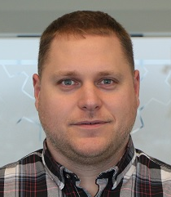
Jan-Tore Pedersen
Senior Consultant @ CTGlobal
Azure Stack HCI/S2D
System Center
Azure
Windows Server Software
https://jtpedersen.com
@jantorep
Speaker and Organizer for SCUG.no

Slide 3
What will be covered
Host Groups
Run As Accounts
Logical Networks
Switch Config
Bare Metal Deployment
Deployment server
Physical Computer Profile
Deployment of a server

Slide 4
How does Bare Metal Deployment in VMM work?

Slide 5
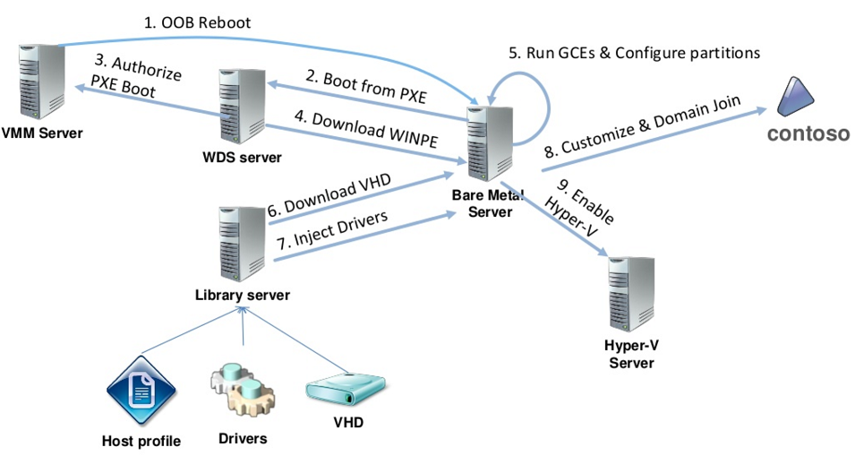

Slide 6
Demo

Slide 7
Thanks for joining
Blog: https://jtpedersen
Twitter: @jantorep
https://storagespacesdirect.slack.com

Slide 8








Danke an unsere Partner!
Platinum Sponsor
Gold Sponsoren

Slide 9





Danke an unsere Partner!
Gold Sponsoren

